Slide 1
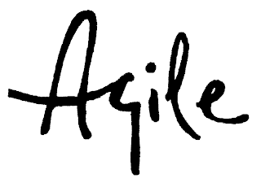
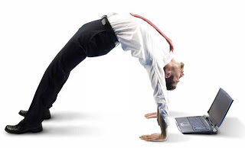
HOW TO LIVE AND SURVIVE LEAN & AGILE IN DAILY BUSINESS
Martin Laza CT RDA DS EU CZ PD AP
Oto Guertler CT RDA DS EU CZ DF FA
Olga Sebestova CT RDA DS EU CZ RA QM
Andrej Cizmar CT RDA DS EU CZ RA HW

Slide 2

Agenda
Morning:
9:00 – 9:10 Introduction
9:10 – 9:30 Expectations
9:30 – 10:00 Marshmallow challenge
10:00 – 10:10 Marshmallow movie
10:10 – 10:20 Break
10:20 – 11:00 Agile project and roles
11:00 – 12:00 Lunch
Afternoon:
12:00 – 12:10 Product vision
12:10 – 12:20 Elevator pitch
12:20 – 12:30 Epic, user stories, tasks
12:30 – 12:40 AC, DoD, DoR
12:40 – 13:00 Multitasking game
13:00 – 13:10 Break
13:10 – 15:00 Lego play
15:00 – 15:10 Go, look, see excercise
15:10 – 15:30 SDS
15:30 – 16:00 Review

Slide 3
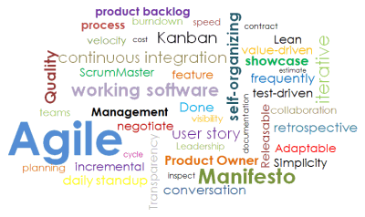
Expectations
Who are you and what do you want to get out of today?

Slide 4
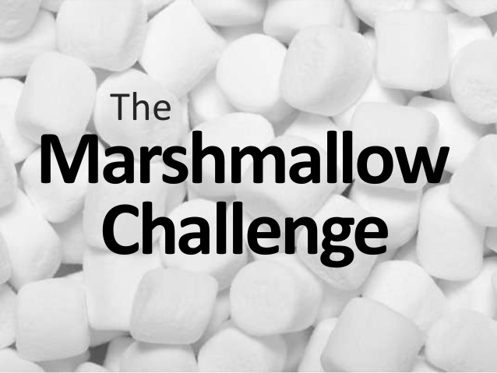
.
The Marshallow challenge
https://www.youtube.com/watch?v=H0_yKBitO8M
https://www.online-stopwatch.com/countdown/

Slide 5
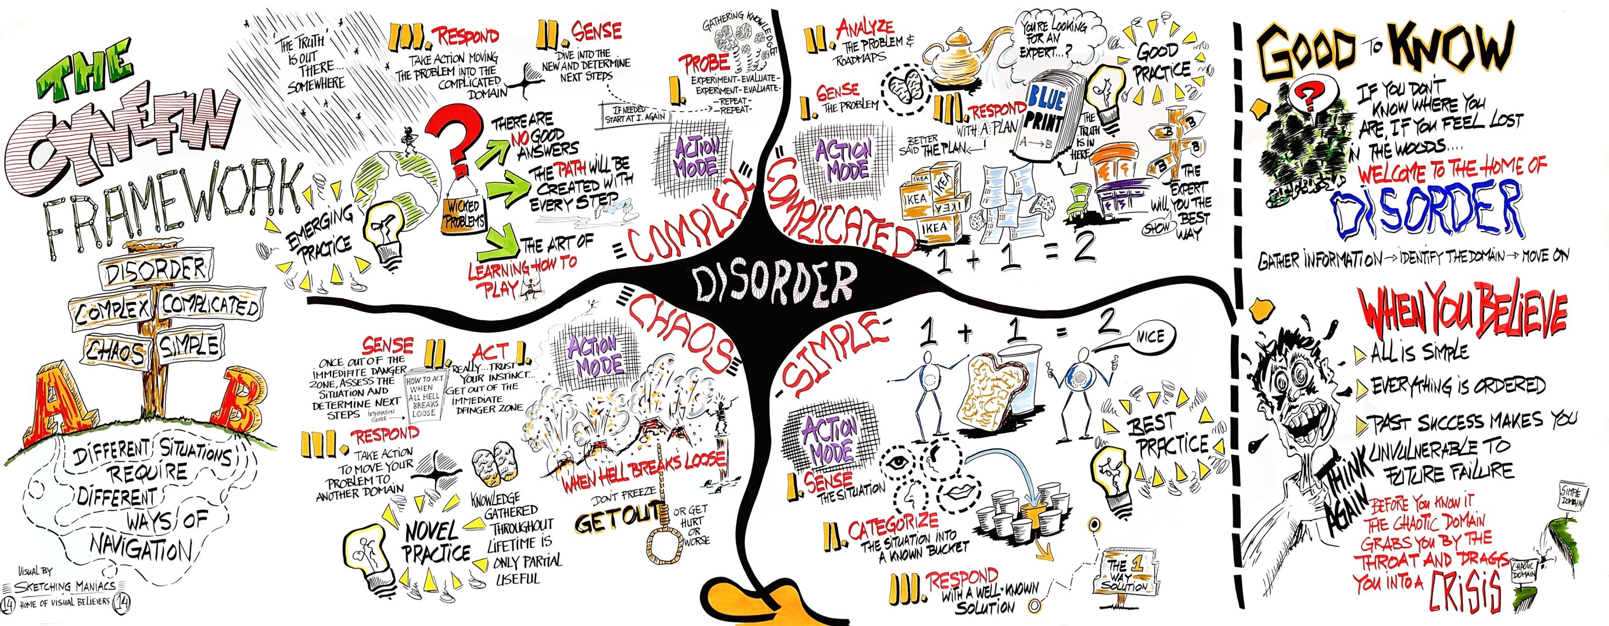
Cynefin Model

Slide 6
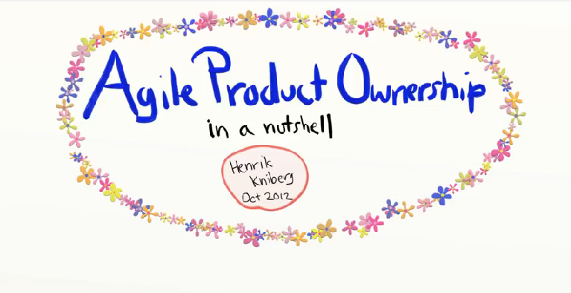

.
Agile project and roles
https://www.youtube.com/watch?v=502ILHjX9EE

Slide 7
.
Why Agile and Lean, Scrum and Kanban were born and became popular?
Reasons
The first reason is the mother of all changes that happen in the business world — it’s market competition
The second reason is the rapid growth of IT and Software market, that introduces other industries to Lean and Agile mindsets
The next reason is the trend toward perfectionism
The last reason is the modern employees’ demands

Slide 8
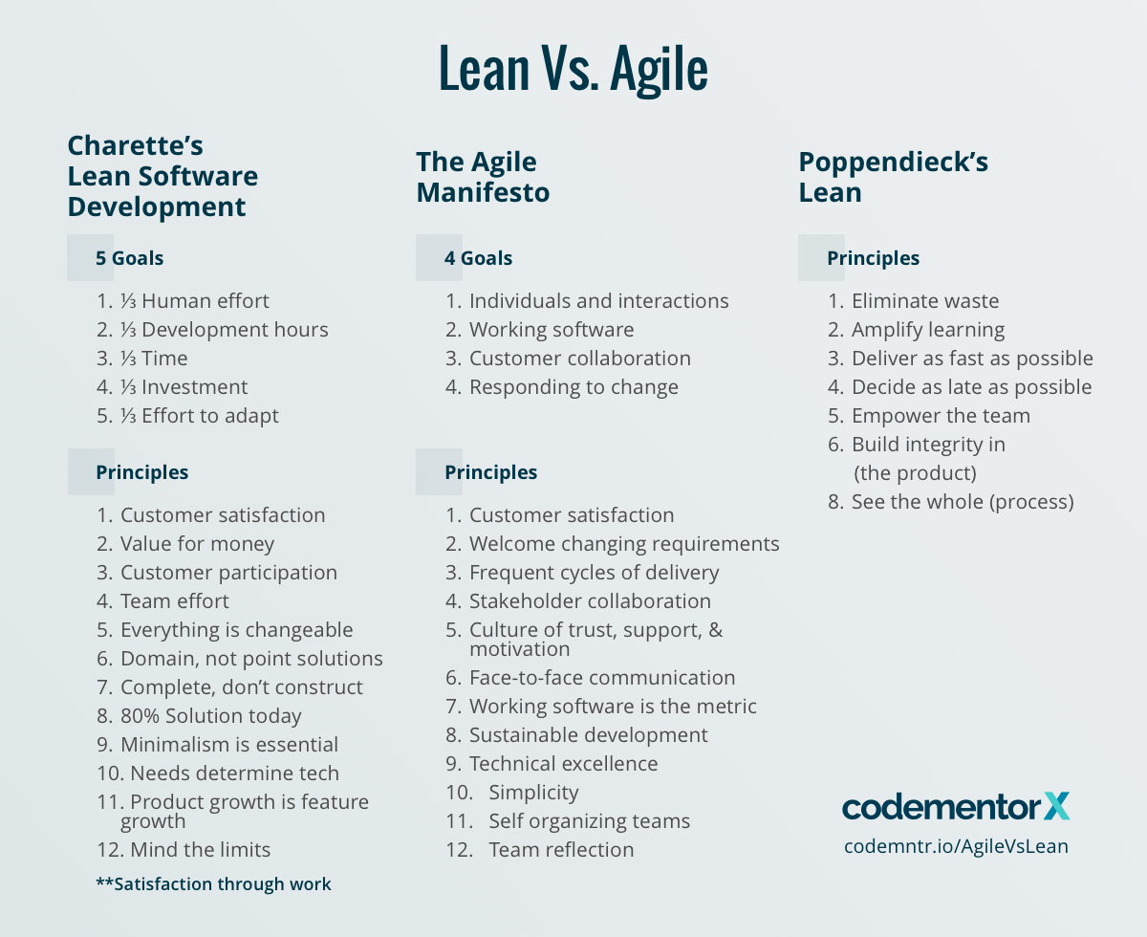
Principles, Manifestos
Agile
Individuals and interactions over processes and tools
Working software over comprehensive documentation
Lean
Eliminate waste
Amplify learning
Lean startup
Entrepreneurs are everywhere
Entrepreneurship is management
Customer collaboration over contract negotiation
Responding to change over following a plan
Decide as late as possible
Deliver as fast as possible
Empower the team
Build integrity in
See the whole
Validated learning
Innovation accounting
Build-measure-learn

Slide 9
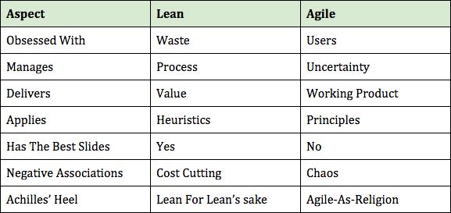
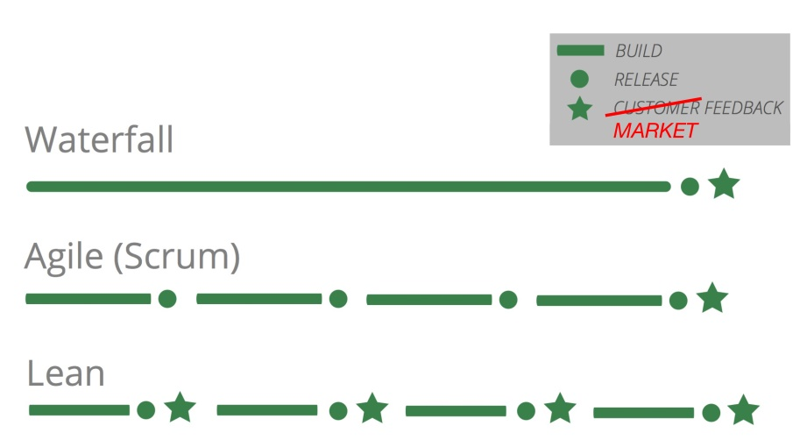
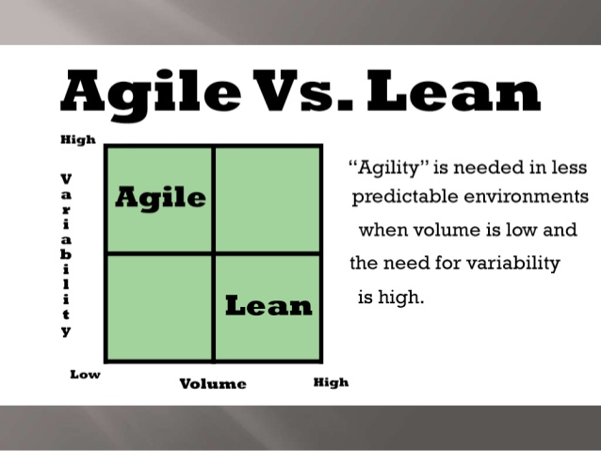
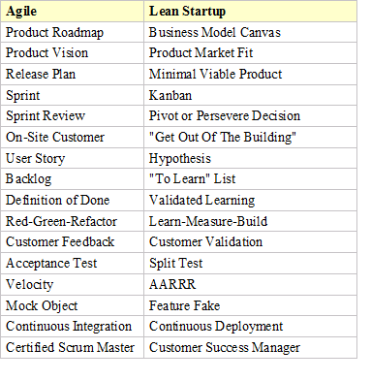
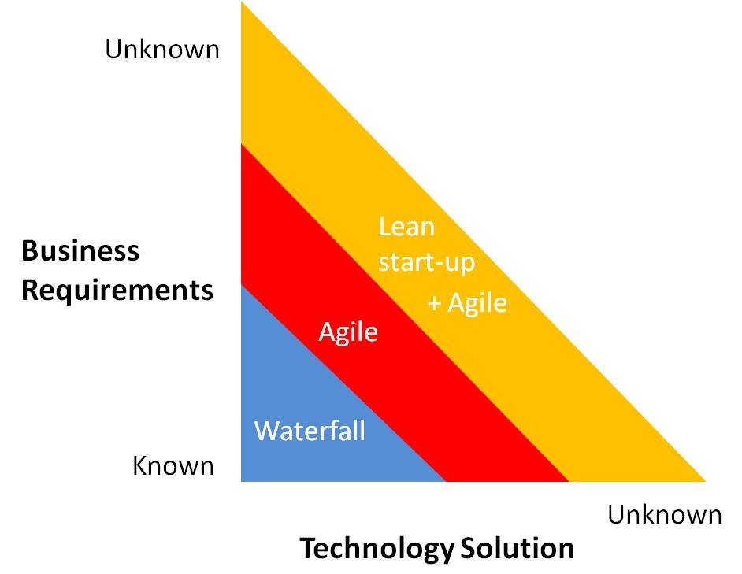
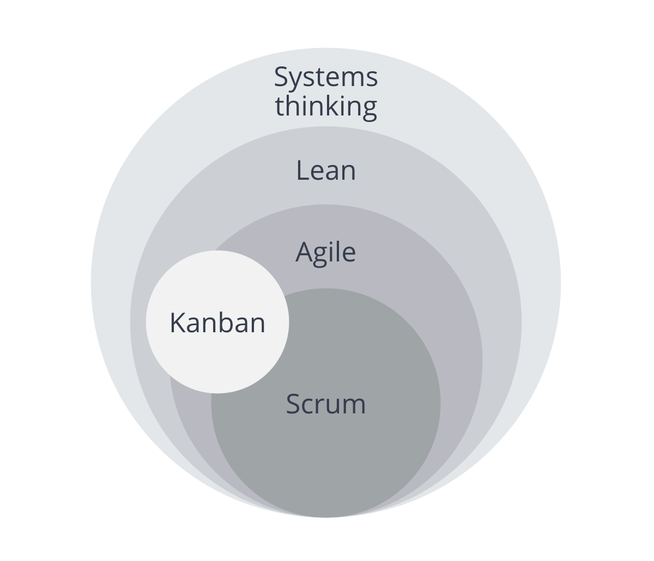
Lean vs. Agile vs. rest of the world

Slide 10
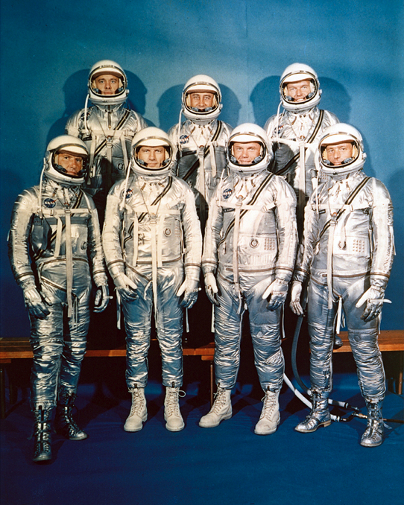
.
Product vision
Vision for landing on the moon
"I believe that this nation should commit itself to achieving the goal, before this decade is out, of landing a man on the moon and returning him safely to the Earth.“
President Kennedy, May 25, 1961

Slide 11
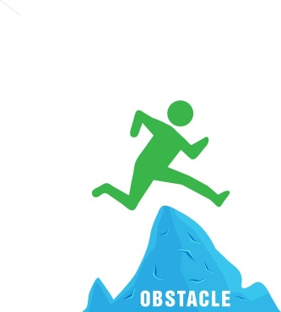
.
Elevator pitch
Template:
FOR <target customer>
WHO <statement of the need>
THE <product name>
IS A <product category>
THAT <key benefit>
UNLIKE <primary competitor>
OUR PRODUCT <further differentiation>
(From Geoffrey Moore, Crossing the Chasm)
Example:
For the OEM,
who wants to commission a drive,
the trace functionality
is a diagnostic support tool,
that can drastically reduce the commissioning time
Unlike the drive of company XXXX
Our trace adjusts automatically to the required recording time and …

Slide 12
Epic, user stories, tasks
User Story
“short, simple description of a feature told from the perspective of the person who needs the feature (usually a user or customer)”
Template:
As a < role>
I want < goal/desire >,
so that < benefit>
Example:
As a user, who often uses the website
I want the system to save my customer data,
so that I can do my shopping faster.

Slide 13
AC, DoD, DoR
Acceptance criteria (AC)
to clarify what the team should build before they start work
to ensure everyone has a common understanding of the ..problem
to help the team members know when the Story is .. ..complete
to help verify the Story via automated tests.
Definition of Done (DoD) an agreement between Development Team and the Product Owner on what needs to be completed for each user story – and it is often standardized across the company in order to guarantee consistent delivery of quality
Definition of Ready (DoR) - clear, feasible and testable, “garbage in, garbage out” Task - is deliberately vague, allowing the precise details that will help the implementation to be discovered at the last responsible moment. Acceptance Criteria are the precise details.
Acceptance Criteria (AC)
Definition of Ready (DoR)
Task
Definition of Done
(DoD)

Slide 14
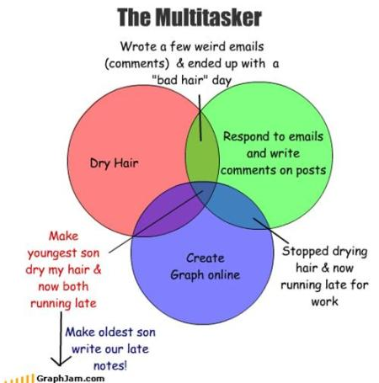
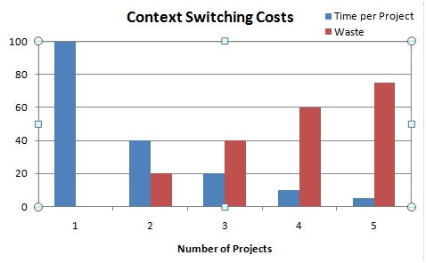
Multitasking game and context switching

Slide 15
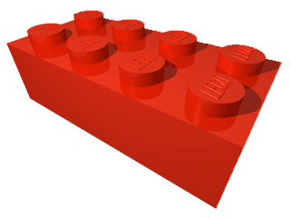
.
SIEMENS LEGO CITY
Vision:
For all the commuting employees,
who wants behave green,
the new SIEMENS LEGO CITY
is a bicycle friendly Siemens campus,
that can drastically reduce CO2 produced by commuting
Unlike our competitor Valeo
Our proximity of Siemens Office building and apartments for our employees creates unique environment friendly concept with balanced work/life ratio

Slide 16
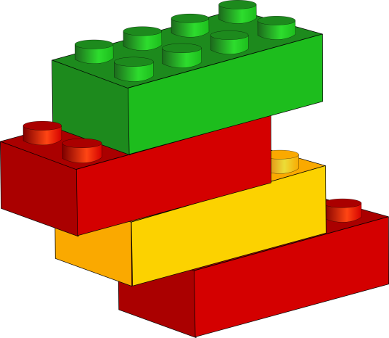

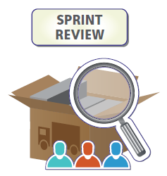

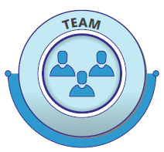
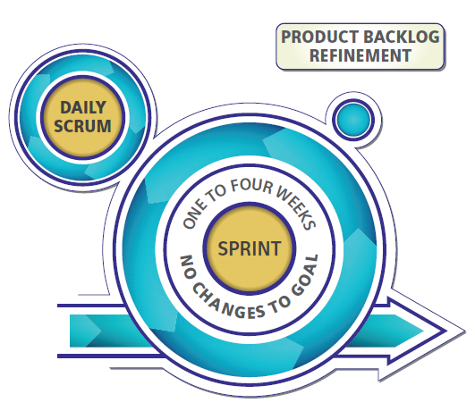
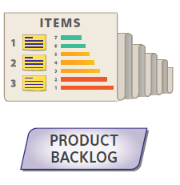
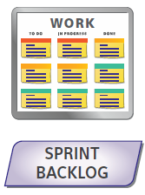

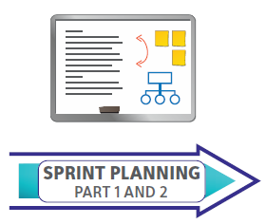
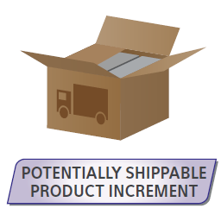
.
LEGO PLAY
Epics/Stories
Plan
2 x 5min
Tasks
10 Minutes
Deliver
Check/Learn

Slide 17
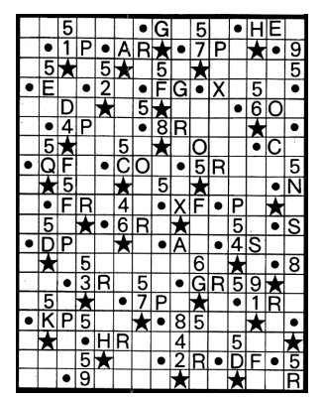
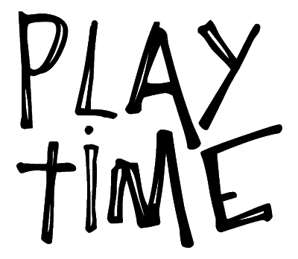
Go, look, see

Slide 18
.
How does it correspond to SDS?
From technical perfectionism and 100 % plan
to continuous customer focus and innovation speed
1
Focus on customer value and eliminate
waste
Respect People
Establish
pull and
flow
Improve continuously
#SDS
Optimize the entire value stream
Go and See
Deliver fast and create knowledge
Build quality in from the beginning
8 Siemens Development System (SDS) Principles

Slide 19
.
How does it correspond to SDS?
1
Value
stream mapping
Structured problem solving
(e.g. A3)
CEO driven Hoshin Kanri
Retro- spectives
Time Boxed Development
Visual Management
Scrum
Self-organizing / cross functional teams
Ranked Backlog
Gemba walk
Value effort matrix
Minimal viable / marketable product
MVP/ MMP
Kanban – WIP limits, definition of done
Daily stand-up meetings
14 Siemens Development System (SDS) Methods

Slide 20

REVIEW
Review What you got out, share with a colleague
Review Car Park
Review Expectations
Training Feedback

